Slide 1
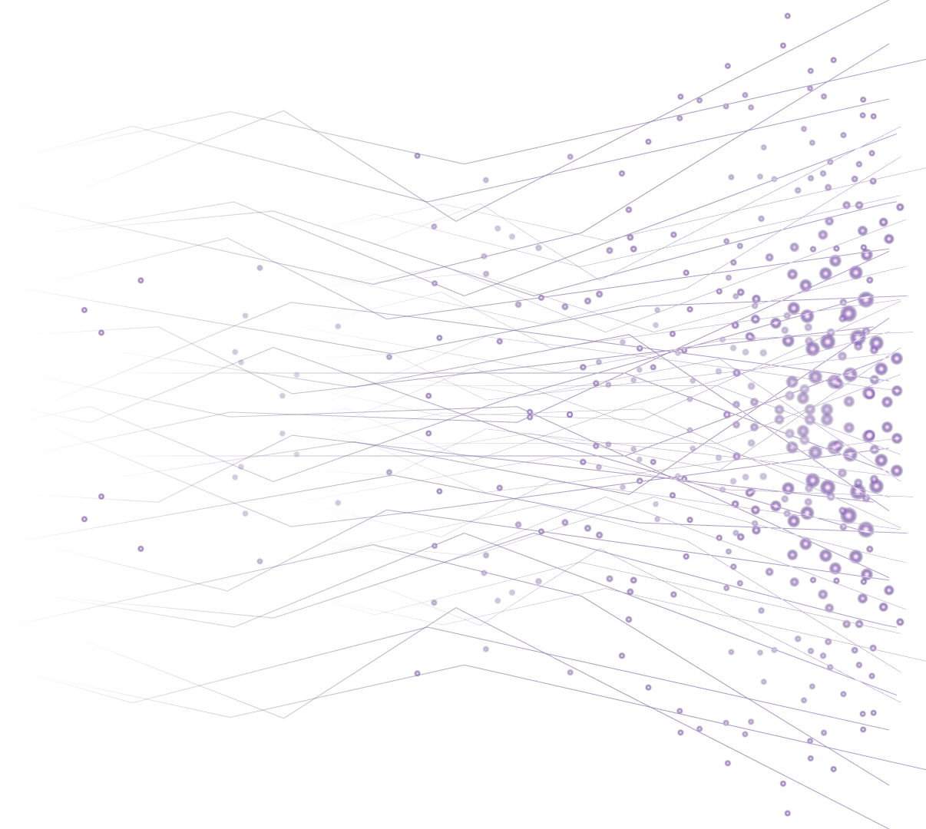

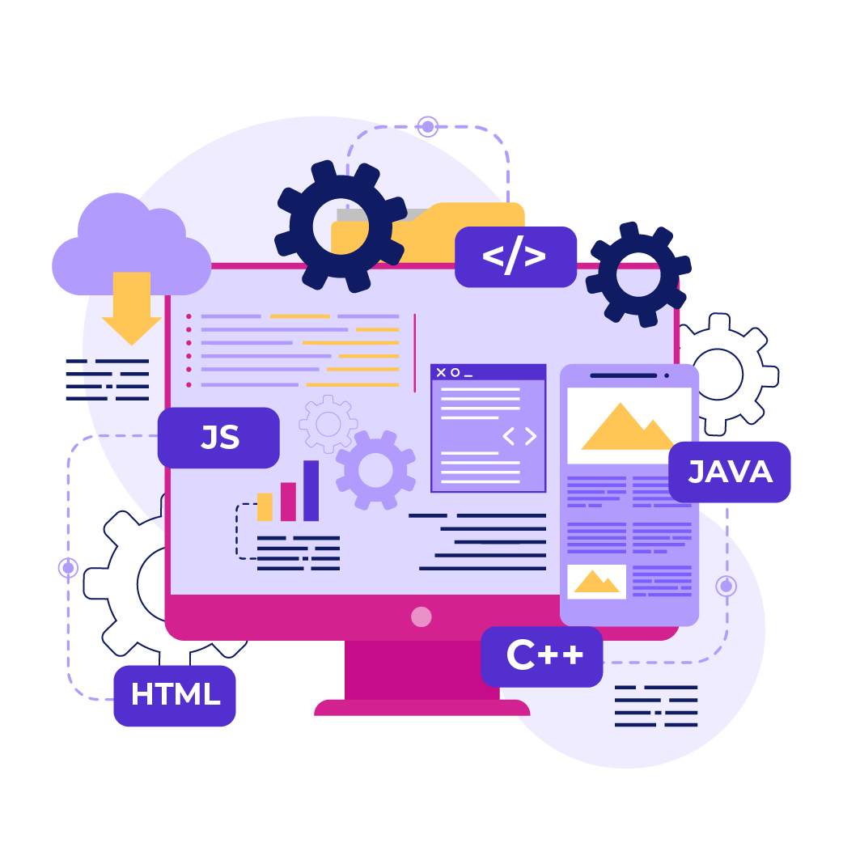
Introduction to
Computer
Programming

Slide 2
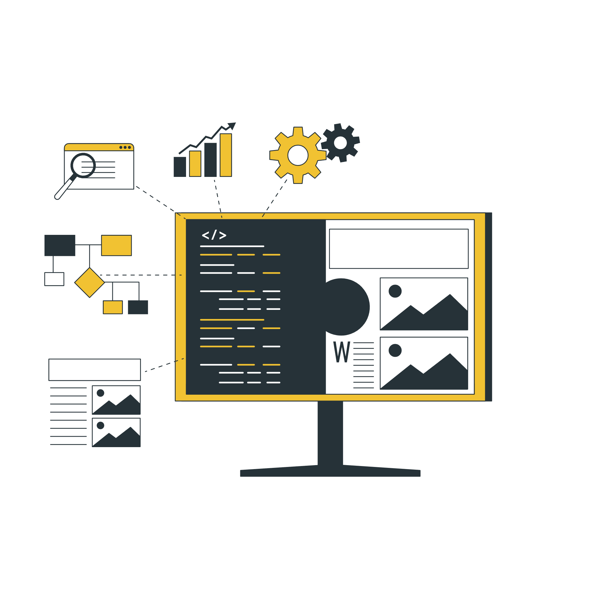
Overview of the
IT Industry
&
Ecosystem

Slide 3

How the IT sector is structured
Infrastructure & Support Examples: Network engineers, system admins, IT support
Software Development Examples: Frontend/backend developers, mobile developers, software engineers
Cloud & DevOps Examples: Cloud engineers, DevOps specialists, site reliability engineers

Slide 4
How the IT sector is structured
Cybersecurity Examples: Security analysts, ethical hackers, security engineers
Data & AI Examples: Data scientists, analysts, AI/ML engineers
User Experience (UX) & Design Examples: UX/UI designers, interaction designers

Slide 5
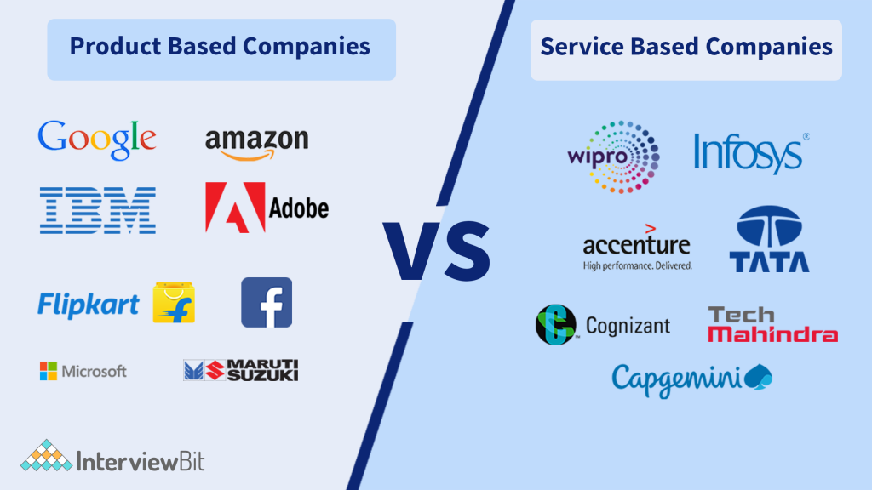
What are different types of IT Companies

Slide 6
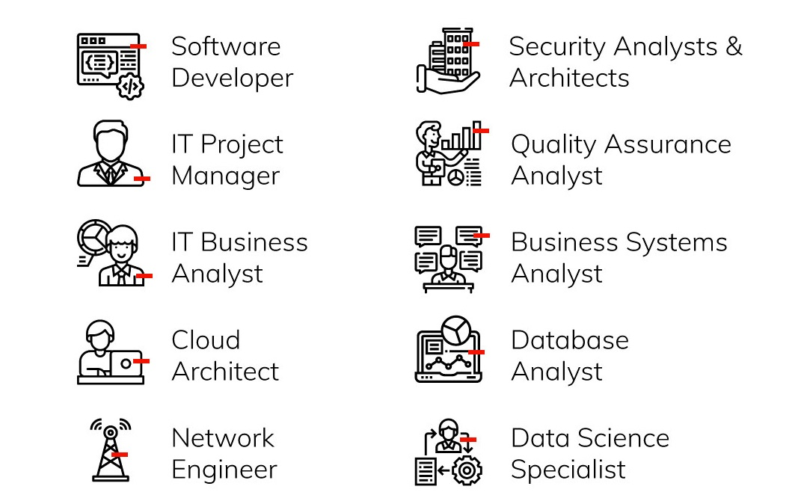
Common roles in IT
Let’s Discuss
One
By
One

Slide 7
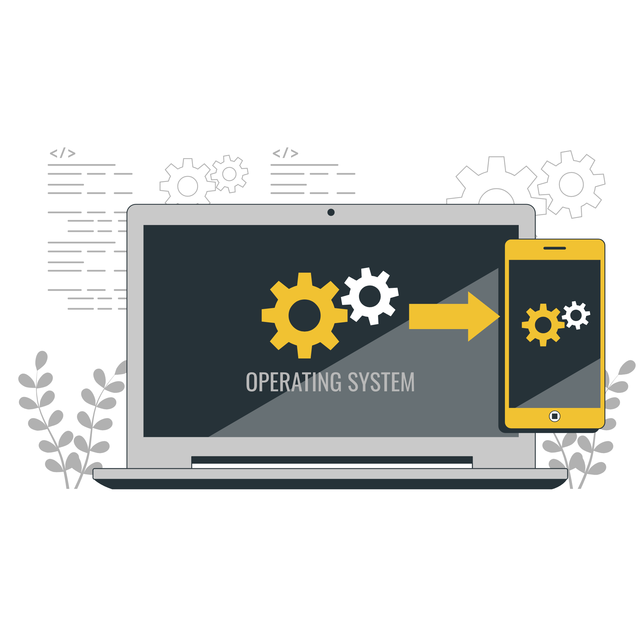
Overview of Software Development Lifecycle (SDLC)
Planning
Define what the software should do.
Set goals, timelines, and resources.
Requirement Analysis
Gather details about what users or clients needs
Understand the problem the software will solve.
Design
Plan how the software will work and look.
Create diagrams, architecture, and interfaces.

Slide 8
Overview of Software Development Lifecycle (SDLC)
Development (Coding)
Programmers write the actual code based on the design.
This is where the product is built.
Testing
Check for bugs and errors.
Make sure the software works as expected.

Slide 9
Overview of Software Development Lifecycle (SDLC)
Deployment
Release the software to users or clients.
Could be a website launch, app release, etc.
Maintenance
Fix issues, update features, and improve performance over time

Slide 10
THANK YOU

